Slide 1



COLUMBIA ASIA HOSPITAL ANALYSIS
Muhammad Sahanwaj

Slide 2

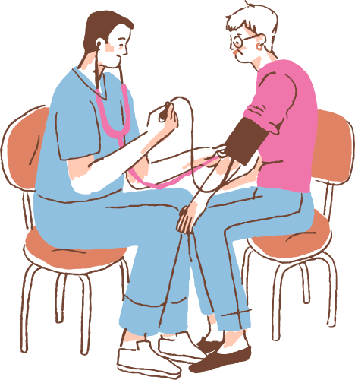

INTRODUCTION
Columbia Asia Hospital stands as a beacon of patient-centered care and medical expertise, renowned globally for its commitment to exceptional healthcare. With a presence across multiple countries, the hospital distinguishes itself through state-of-the-art medical equipment, modern amenities, and a team of compassionate, highly skilled professionals. Dedicated to excellence, Columbia Asia Hospital is committed to fostering a healthy society by delivering comprehensive and personalized healthcare solutions tailored to the diverse needs of its communities. At its core, the hospital prioritizes patient needs, ensuring holistic and effective medical

Slide 3


DATA OVERVIEW
I've received two essential files from the team: one containing detailed transactional data on doctor-patient interactions, including patient race, age, appointment fees, appointed doctor, and other pertinent details. The other file, from the Hospital ER, provides comprehensive master data on billing, encompassing total bills, doctor names, patient IDs, and departments.
Both datasets are substantial, each containing over 6000 rows, making them highly valuable for making informed analytical decisions.
To proceed, I imported these datasets into Microsoft Power BI using the Get Data option and conducted initial data transformation steps to ensure cleanliness and relevancy in both tables. This preparation sets the stage for in-depth analysis and actionable insights from the integrated data sources.

Slide 4


METHODOLOGY
Analytical Methods: Utilized Power BI for data analysis and visualization.
Tools Used: Power BI Desktop, Power Query Editor, DAX.
Steps Taken: Data Cleaning: Removed duplicates, handled missing values, and standardized formats using Power Query Editor.
Data Enrichment: Joined datasets to enable comprehensive analysis.
Measure Creation: Developed DAX measures for key performance indicators.
Visualization: Created various visualizations for presenting insights.
Specific DAX Functions: SUM, AVERAGE, RELATED, CALCULATE, etc.
This methodology provides a succinct overview of the analytical approach, tools used, and steps taken in the analysis process, including data cleaning, enrichment, measure creation, and visualization, with a mention of specific DAX functions utilized.

Slide 5

PROBLEM STATEMENT
The Hospital is looking for key insights
Insights about suitable departments for new hires.
Strategies and suggestions about patient discount eligibility and criteria.

Slide 6

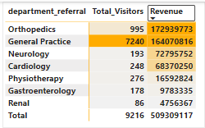
TOTAL REVENUE, DEPARTMENT WISE REVENUE
The table reveals the revenue distribution across different hospital departments.
Orthopedics leads with revenue of 172,939,773.
General Practice follows with revenue of 164,070,816.
Neurology generates 72,795,752 in revenue.
Cardiology has a revenue of 68,370,450.
Physiotherapy generates 16,592,824 in revenue.
Gastroenterology reports revenue of 9,783,335.
The renal department accounts for 4,756,367 in revenue.
This graphical representation highlights Orthopedics as the top revenue-generating department, underscoring its critical role in the hospital's financial stability and guiding further resource allocation and investment planning.

Slide 7


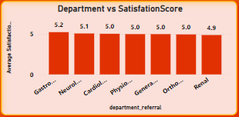
DEPARTMENT-WISE SATISFACTION SCORE
Gastroenterology stands out with an impressive average satisfaction rating of 5.2.
Neurology and physiotherapy are closely followed, with ratings of 5.1 for each.
Orthopedics and General Practice both maintain solid ratings of 5.0.
Cardiology holds a rating of 5.0.
Renal exhibits a rating of 4.9.

Slide 8
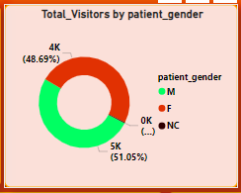
TOTAL VISITORS BY PATIENT GENDER
The pie chart illustrates an equitable gender distribution among hospital visits.
Men account for 51.05% of visits.
Women represent 48.69% of visits, totaling 4,487 visits.
This balanced representation underscores the hospital's inclusive environment, accommodating a diverse spectrum of patients.

Slide 9




HOSPITAL PROFITABILITY
The hospital's revenue increased from ₹240,408,248 in 2019 to ₹268,900,869 in 2020, indicating a growth in patient visits or service utilization.
This upward trend suggests potential profitability, provided that operational costs have not increased proportionally.

Slide 10

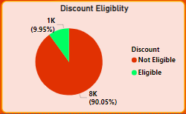
DISCOUNT ELIGIBILITY
Discounts can be offered based on factors like visit frequency, satisfaction score, appointment fees, and low-traffic departments to boost engagement.
In this case, patient satisfaction scores will determine discount eligibility due to limited cost data per department.
Patients with a satisfaction score above 6 qualify for the discount.
There are 9.95% patient who has patient satisfaction score is more than 6 which are eligible for discount.

Slide 11
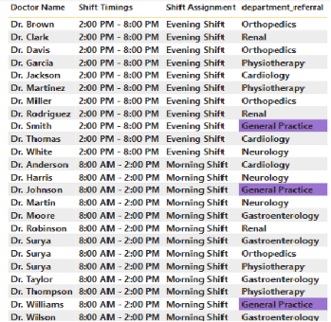
SHIFT ASSIGNMENT
Shift Allocation: Dr. Jackson and Dr. Williams will cover the morning shift from 8:00 AM to 2:00 PM, and Dr. Smith will handle the evening shift from 2:00 PM to 8:00 PM.
Optimized Patient Care: This shift allocation addresses higher patient traffic in the morning, ensuring efficient resource utilization and better patient care.
Improved Patient Flow: Splitting shifts in the General Practice department reduces wait times and streamlines operations, enhancing patient experience.
Enhanced Revenue: Aligning doctor shifts with peak demand boosts hospital revenue by optimizing service delivery and addressing high visitor numbers effectively.

Slide 12
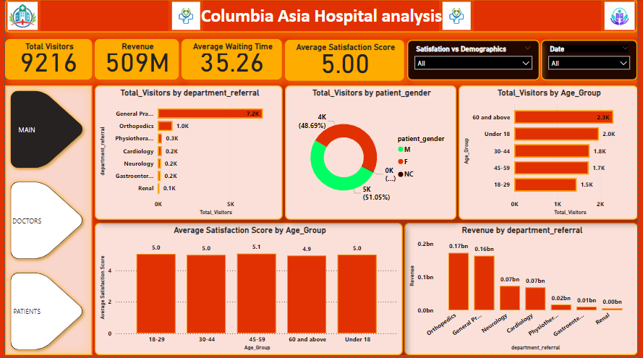

MAIN

Slide 13
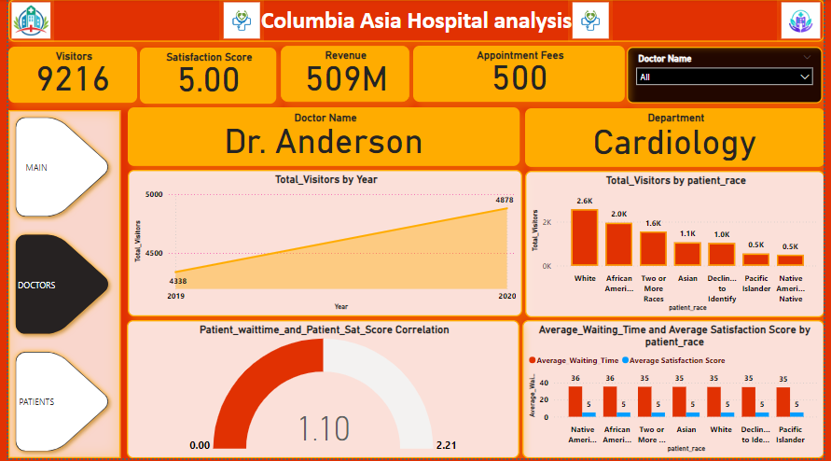
DOCTORS

Slide 14
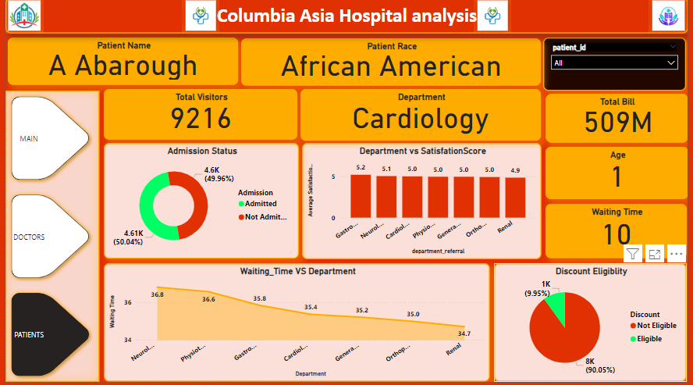
PATIENTS

Slide 15
CONCLUSION
Demographics and Engagement: Understanding patient demographics helps tailor services and marketing for better engagement.
Inclusive Care: Examining visitor numbers by gender supports inclusive healthcare strategies.
Resource Allocation: Revenue insights guide efficient resource distribution across departments.
Demand Forecasting: Tracking visitor trends aid in demand forecasting and staffing optimization.
Operational Efficiency: Targeted discounts and adjusted doctor shifts based on patient flow improve satisfaction and operational performance.
In summary, these insights drive strategic decisions, enhancing patient care and supporting sustainable growth.

Slide 16
THANK YOU

